Slide 1
Secondary Structure Prediction with Support Vector Machines
J. J. Ward, L. J. McGuffin, B. F. Buxton and D. T. Jones
BIOINFORMATICS, Vol. 19, no.13 ,Pages 1650–1655, 2003
Presenter: Jun-Shong Lin
Date: August 3, 2006

Slide 2
Abstract
Motivation:
A new method that uses support vector machines(SVMs) to
predict protein secondary structure is described and evaluated.
The study is designed to develop a reliable prediction method
using an alternative technique and to Investigate the applicability
of SVMs to this type of bioinformatics problem.
Methods: Binary SVMs are trained to discriminate between
two structural classes. The binary classifiers are combined in
several ways to predict multi-class secondary structure.

Slide 3
Abstract(cont.)
Results: The average three-state prediction accuracy per
protein (Q3) is estimated by cross-validation to be 77.07 ±
0.26% with a segment overlap (Sov) score of 73.32±0.39%.
The SVM performs similarly to the ‘state-of-the-art’ PSIPRED
prediction method on a non-homologous test set of 121 proteins
despite being trained on substantially fewer examples.
A simple consensus of the SVM, PSIPRED and PROFsec
achieves significantly higher prediction accuracy than the
individual methods.
Availability: The SVM classifier is available from the authors.
Work is in progress to make the method available on-line and
to integrate the SVM predictions into the PSIPRED server.

Slide 4
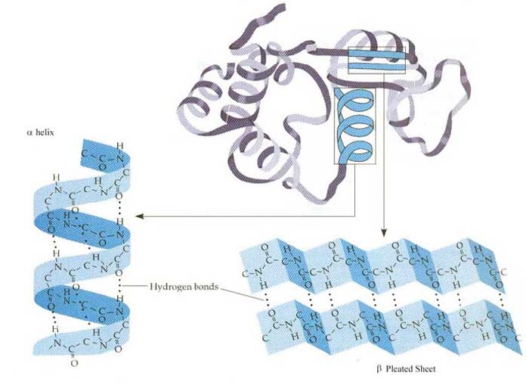
Secondary Structure of Protein
Secondary structure:
  α-helix
  β-sheet
  loop

Slide 5
Why Secondary Structure?
Helps solve tertiary structure
(3-d shape)
Shape = Function

Slide 6
Protein Prediction Methods
In the recent approach
  PHD (1990s)
    artificial neural network
  PSIPRED(1999)
    PSI-BLAST + artificial neural network
  JPred(1999)
    Combine several methods
  PSA
    Markov model

Slide 7
Secondary Structures
(Classes)
1. Helix (H)
– α-helix, 3₁₀-helix
2. Strand (E)
– sheet and isolated β-bridge
3. Coil (C)
– π-helix, turn, bend and other

Slide 8
Implementation
Training Set
– Sets of proteins were clustered, such that no 2
proteins had > 25% similarity between 2 clusters
– 1 representative protein from each cluster was
selected and added to training set
– Totaling 1460 non-redundant proteins
Testing Set
– Cross Validation

Slide 9
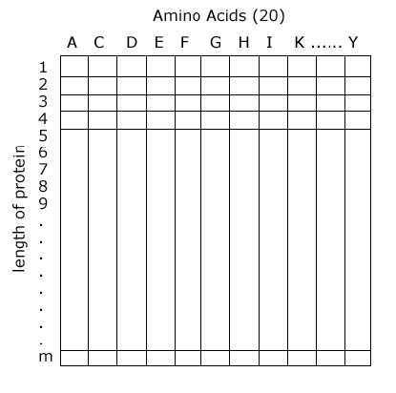
SVM Inputs
Values in the matrix come from a scoring matrix of a
PSI-BLAST search.
acdddeegahikydacgskkddeaahikyda
Window of 15:
acdddeegahikyda
Perform BLAST iteratively
3 times to get frequencies.

Slide 10
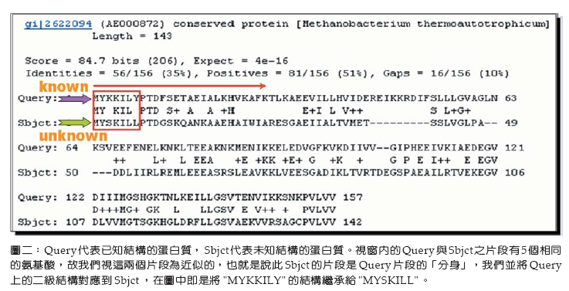
PSI-BLAST
PSI-BLAST程式一Position-Specific Iterated BLAST（Altschul, et al., 1997）
http://www.ncbi.nlm.nih.gov/Education/BLASTinfo/psi1.html

Slide 11
Methods
Multi-class handled with ‘one-versus-rest’
and ‘one-versus-one’
3 fold cross validation
Uses SVMLight
Order 2 polynomial kernel was best in their
  tests.

Slide 12
Methods
one-versus-rest
- H/~H
- E/~E
- C/~C
Input
C
Not C
E
Not E(H)

Slide 13
Methods
one-versus-one
- E/C
- C/H
- H/E
C or H
vote
Input
C or E
Argue max
vote
vote
H or E

Slide 14
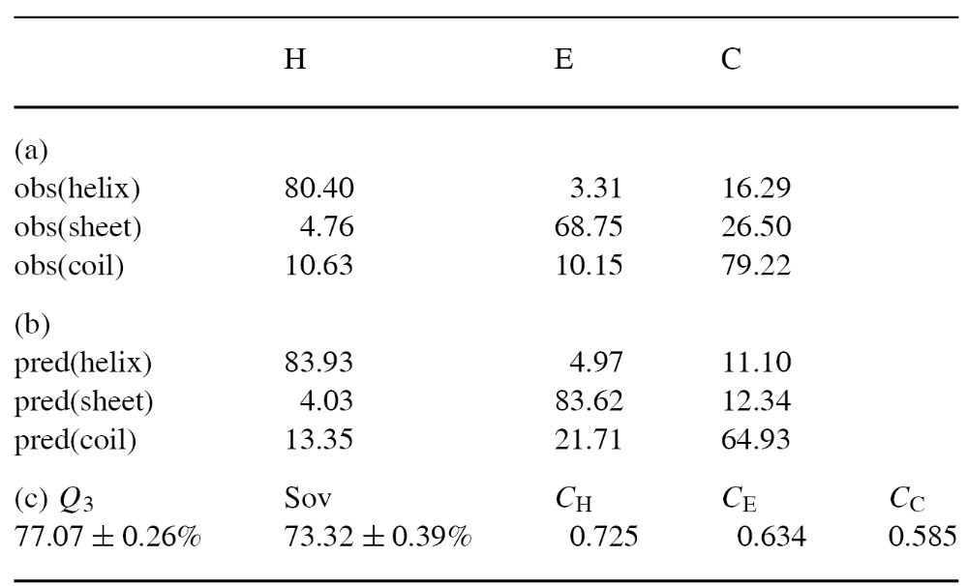

Result
Results from 3-fold cross-validation of the final SVM prediction
method on a data set of 1095 proteins

Slide 15
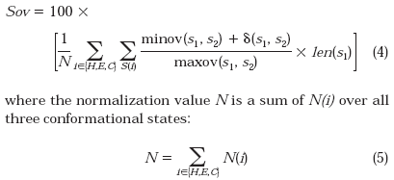

Definition of Sov
Sov (Segment Overlap Score)

Slide 16
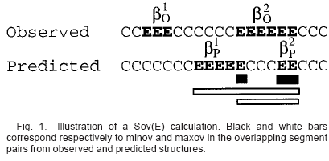



Definition of Sov(cont.)
EXAMPLE:

Slide 17
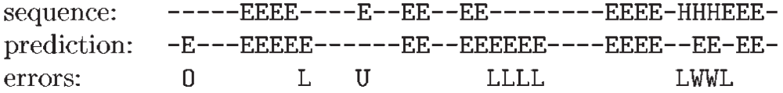
Result(cont.)
Structure
E :sheet
H :helix
- :coil
There are four type errors
Length errors, which occur at the ends of correctly predicted helix or sheet elements.
Over-predictions, where a coil segment is predicted as helix or strand.
Under-predictions, where helix or strand segments are predicted as coil.
Wrong predictions, where strand is misclassified as helix and vice versa.

Slide 18
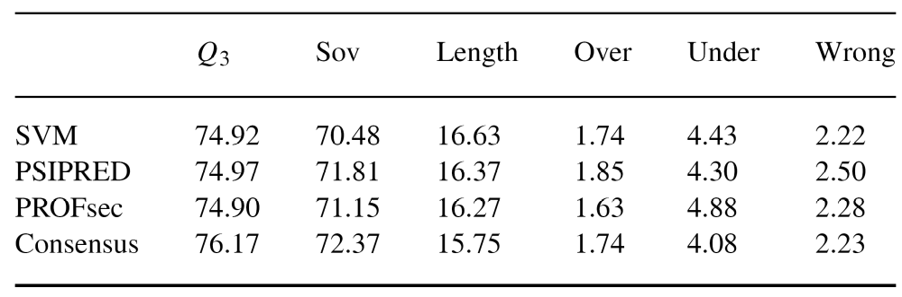
Result(cont.)
Accuracy scores for the SVM method compared to PSIPRED,
PROFsec and a consensus of these methods on a test set of 121 proteins

